Slide 1
A Hybrid Approach for Detecting Automated Spammers in Twitter
BY:
Polu Sai Ashish Roll No: 1009-19-862-028
Masters of Computer Applications
Nizam College, Hyderabad.
Under Supervision of:
Prof. Humera Shaziya Department of Informatics
Nizam College, Hyderabad.

Slide 2
Contents:
Objective
Purpose
Existing System
Proposed System
Software Requirements
Hardware Requirements
Modules
UML Diagrams

Slide 3
Objective
Twitter is one of the most popular microblogging services, which is generally used to share news and updates through short messages restricted to 280 characters. However, its open nature and large user base are frequently exploited by automated spammers, content polluters, and other ill-intended users to commit various cybercrimes, such as cyber bullying, trolling, rumor dissemination, and stalking. Accordingly, a number of approaches have been proposed by researchers to address these problems.

Slide 4
Purpose:
In this project, we present a hybrid approach for detecting automated spammers by amalgamating community-based features with other feature categories, namely metadata-, content-, and interaction-based features. The novelty of the proposed approach lies in the characterization of users based on their interactions with their followers given that a user can evade features that are related to his/her own activities, but evading those based on the followers is difficult. Nineteen different features, including six newly defined features and two redefined features, are identified for learning three classifiers, namely, random forest, decision tree, and Bayesian network, on a real dataset that comprises benign users and spammers. The discrimination power of different feature categories is also analyzed, and interaction- and community-based features are determined to be the most effective for spam detection, whereas metadata-based features are proven to be the least effective.

Slide 5
Existing System:
Sahami et al. [14] proposed textual and non-textual and domain-specific features and learned naive Bayes classifier to segregate spam emails from legitimate ones. Schafer [15] and [16] proposed metadata-based approaches to detect botnets based on compromised email accounts to diffuse mail spams. Spam campaigns on Facebook were analyzed by Gao et al. [10] using a similarity graph based on semantic similarity between posts and URLs that point to the same destination.
Furthermore, they extracted clusters from a similarity graph, wherein each cluster represents a specific spam campaign. Upon analysis, they determined that most spam sources were hijacked accounts, which exploited the trust of users to redirect legitimate users to phishing sites. In [7] and [8], honey profiles were created and deployed on OSNs to observe the behavior of spammer. Both studies presented different sets of features to discriminate benign users from spammers and evaluated them on different sets of OSNs.

Slide 6
Proposed System:
In the proposed system, the system proposes a hybrid approach for detecting social spam bots in Twitter, which utilizes an amalgamation of metadata-, content-, interaction-, and community-based features. In the analysis of characterizing features of existing approaches, most network-based features are not defined using user followers and underlying community structures, thereby disregarding the fact that the reputation of user in a network is inherited from the followers (rather than from the ones user is following) and community members. Therefore, the system emphasizes the use of followers and community structures to define the network-based features of a user.
The system classifies set of features into three broad categories, namely, metadata, content, and network, wherein the network category is further classified into interaction- and community-based features. Metadata features are extracted from available additional information regarding the tweets of a user, whereas content-based features aim to observe the message posting behavior of a user and the quality of the text that the user uses in posts. Network-based features are extracted from user interaction network.

Slide 7
System Requirements:
Operating System - Windows XP
Coding Language - Java/J2EE(JSP,Servlet)
Front End - J2EE
Back End - MySQL

Slide 8
Hardware Requirements :
➢ Processor - Pentium –IV
➢ RAM - 4 GB (min)
➢ Hard Disk - 20 GB
➢ Key Board - Standard Windows Keyboard
➢ Mouse - Two or Three Button Mouse
➢ Monitor - SVGA

Slide 9
Modules :
After looking at the functional requirements it is identified that we can divide the system into the following modules such as:
a)Tweet admin
b)Friend Request and Response
c)User
d)Searching users to make friends

Slide 10
UML Diagrams
Use case diagrams -Use cases are used during requirements elicitation and analysis to represent the functionality of the system. Use cases focus on the behavior of the system from the external point of view.
Class Diagrams - Class diagrams are used to describe the structure of the system. Classes are abstraction that specify the common structure and behavior of a set Class diagrams describe the system in terms of objects, classes, attributes, operations and their associations.
Sequence diagrams - Sequence diagrams are used to formalize the behavior of the system and to visualize the communication among objects. They are useful for identifying additional objects that participate in the use cases. A Sequence diagram represents the interaction that take place among these objects.

Slide 11
State chart diagrams – State chart diagrams describe the behaviour of an object as a number of states and transitions between states. A state represents a particular set of values for an object and focuses between states.
Activity Diagram -An activity diagram describes a system in terms of activities. Activities are states that represents the execution of a set of operations. Activity diagrams are similar to flowchart diagram and data flow.

Slide 12
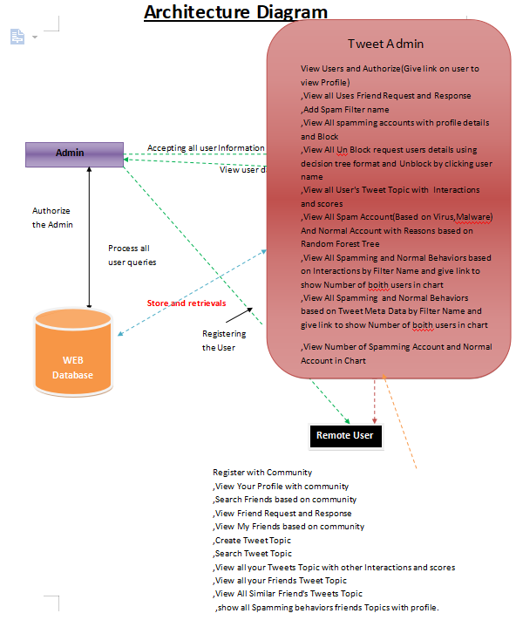
Architecture Diagram:

Slide 13
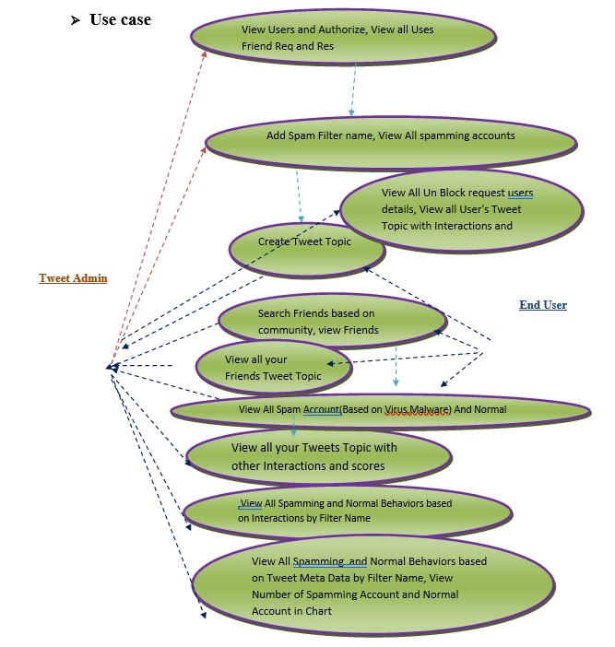
Use Case Diagram:

Slide 14
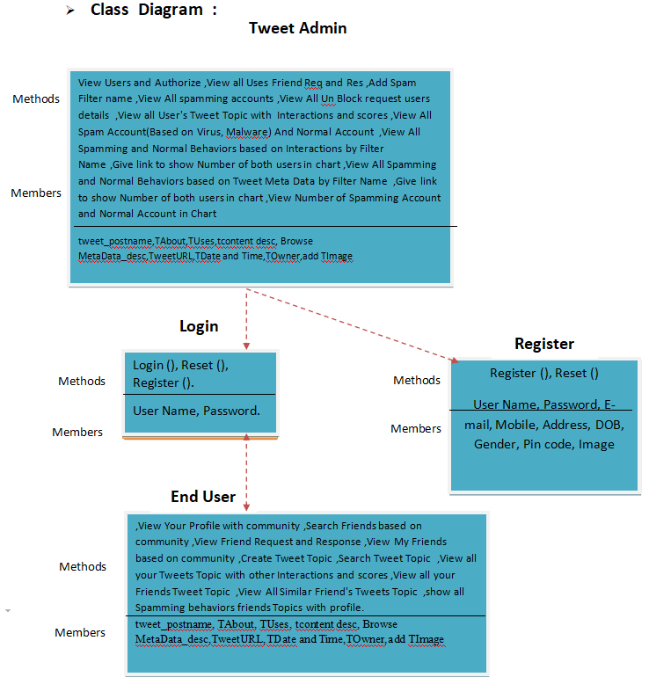
Class Diagram:

Slide 15
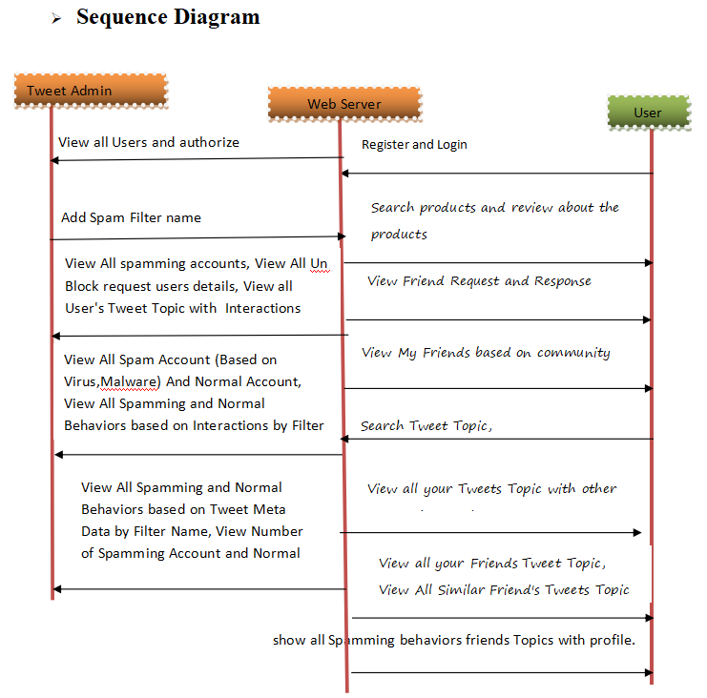
Sequence Diagram:

Slide 16
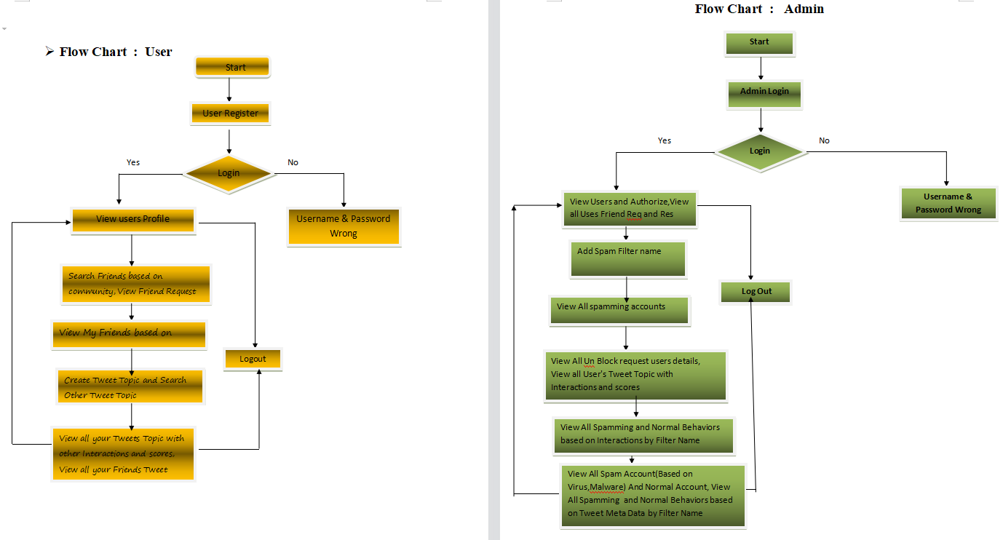
Flow chart diagram:

Slide 17
Thank you!

